Slide 1
Procurement process analysis for Green Air Inc.
Madarasi Nora Greta
2024.06.13

Slide 2
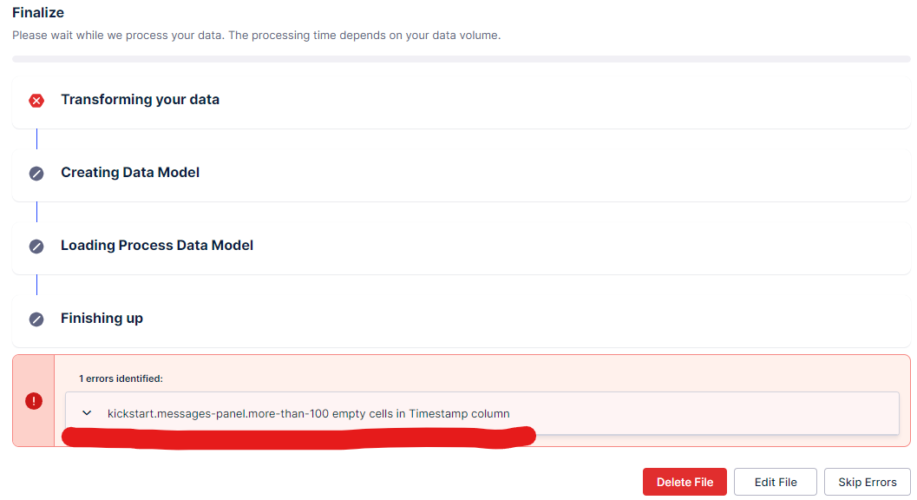
Disclaimer:
There is a slight difference between the dataset I used for Celonis and the dataset I analysed in Jupyter notebook. The reason is coming from the missing values: In the standard process flow usually there is no PR and PO rejection (or quite rare), the cases (CaseID-s) with those missing values does not need special attention, therefore I excluded these items in my analysis in Jupyter Notebook. However when I tried to upload this data to Celonis there were still more than 100 missing value items in TimeStamp feature, and therefore decided to first drop all the rows with no data in TimeStamp column (df3 = df2.dropna(subset=['Timestamp'])) and use this dataset in Celonis.
Option 1 – event log processing. Reason: Python intermediate level – higher confidency level.

Slide 3
Case study summary
Period of one month: 2020.10.01 - 2020.10.29 (based on PR creation)
Total 438 cases – 84% follows standard process
Stakeholders: PR creators: 4, PO creators: 4
Approvers: PR authorizers: 3, PO authorizers: 3
Data quality with missing values (no duplicates, 427 PO completed, 375 PR completed)
Total 17 Suppliers – vendor management
Total spend of 823 205 EUR in 5 categories – category management

Slide 4
Understanding the data EDA
Analysis by visualisations

Slide 5

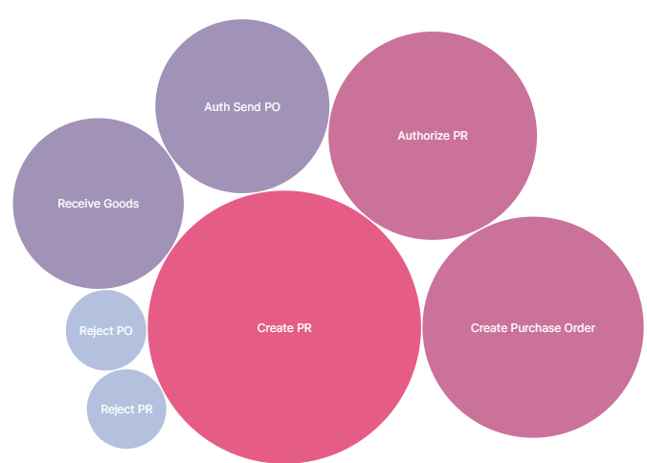
Activities
The most frequent activiy is create PR which makes sense since even if and order is not successfully placed and sent to supplier (for example rejected) the first step as PR creation is still performed.
Activities with the smallest frequency is the PR and PO rejection – this can be a room for improvement to reduce the number of these activities.

Slide 6
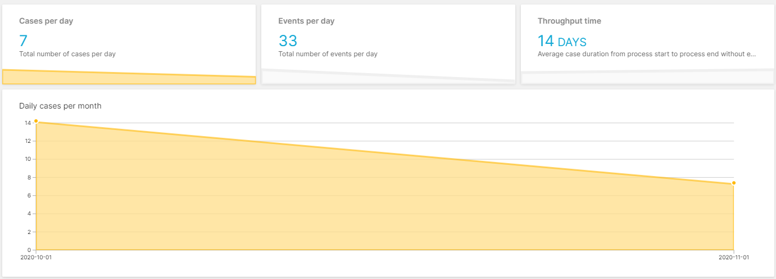
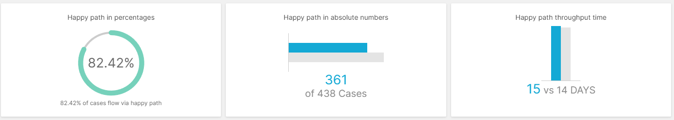
General overview

Slide 7
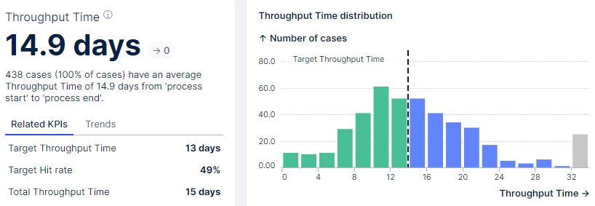
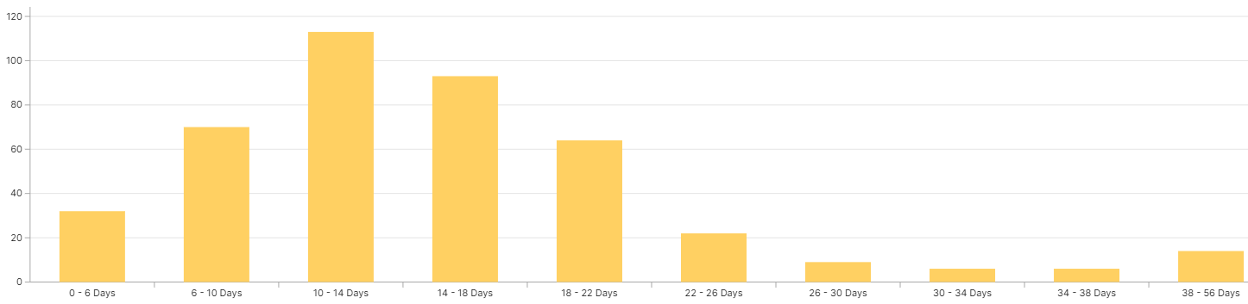
How long does the process take?
In case of taking the average (which is sensitive to outliers) the lead time is approximately 15 days. Since it gives us more or less a normal distribution, it means that in most of the cases the average lead time applies.
However it also drags the attention to the cases which exceeds the 15 days → process improvement on lead time reduction, identifying the reasons behind.

Slide 8
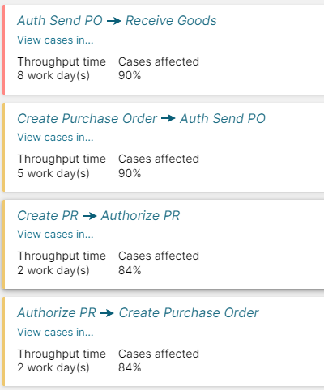
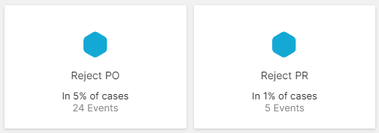
Bottlenecks
As per the analysis from Celonis the first longest lead time (8 working days) appears from sending the PO to receive goods – this is pending on the Supplier.
The second longest lead time is taking 5 working days from PO creation to auth & send PO → internal process check.

Slide 9
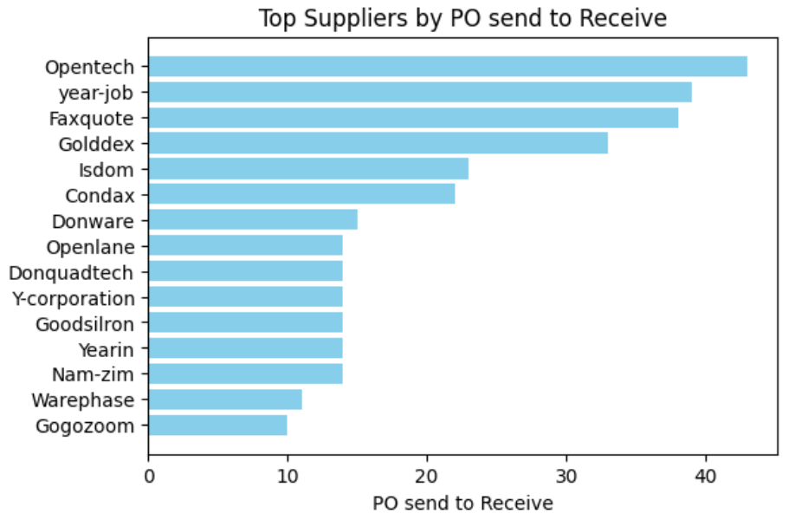
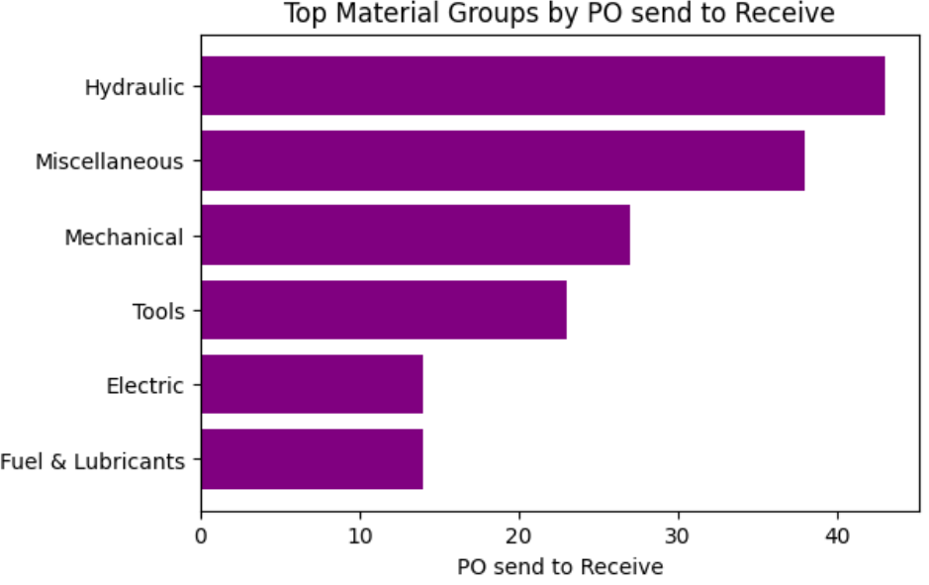
Bottlenecks
Suppliers sending the goods by more than 8 days later than the PO was sent to them by Green Air Inc.
Recommendation: starting with the top 3: Opentech, year-job, Faxquote (Golddex, Isdom, Condax...)

Slide 10
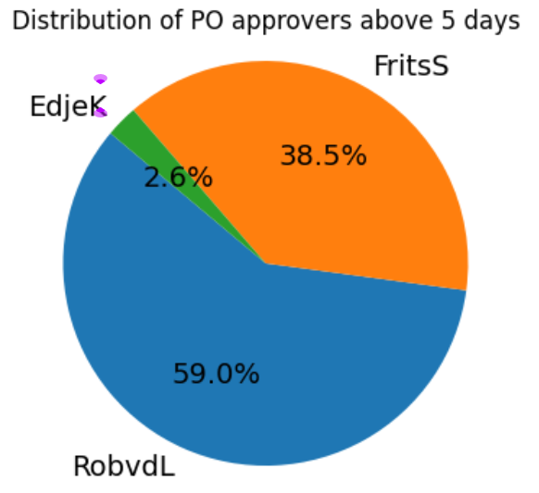
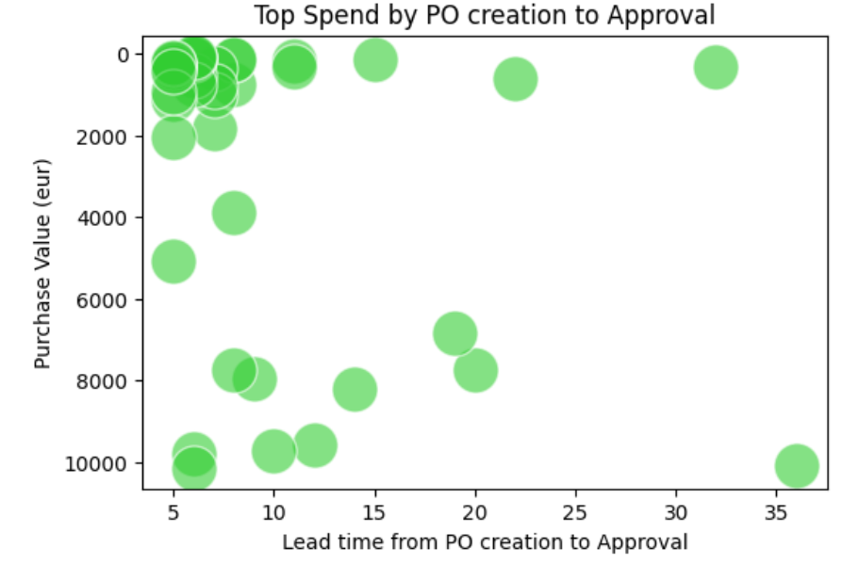
Bottlenecks
Most of the PO-s with delayed (more than the average 5 working days) approval time are approved by RobvdL and FritsS. There is no further pattern to be identified if those PO-s has the same high amount or raised for the same suppliers or in the same category.
Recommendation: discussion with RobvdL and FritsS in order to understand the reason behind.

Slide 11
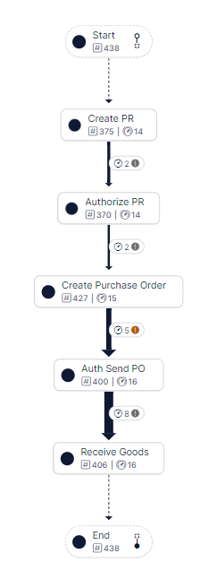
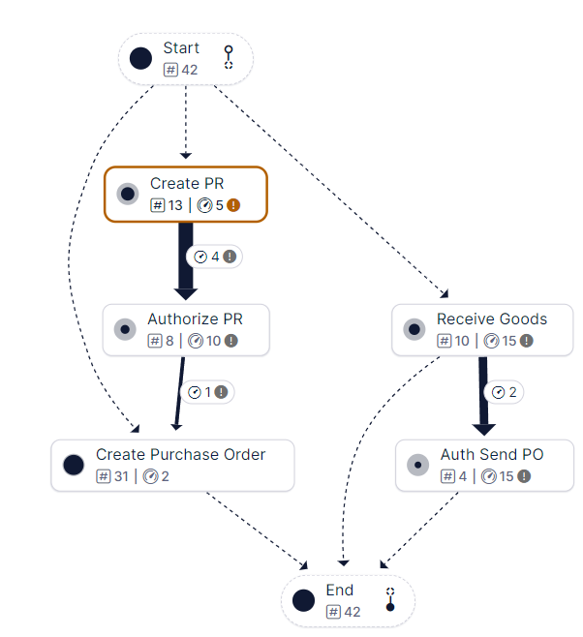
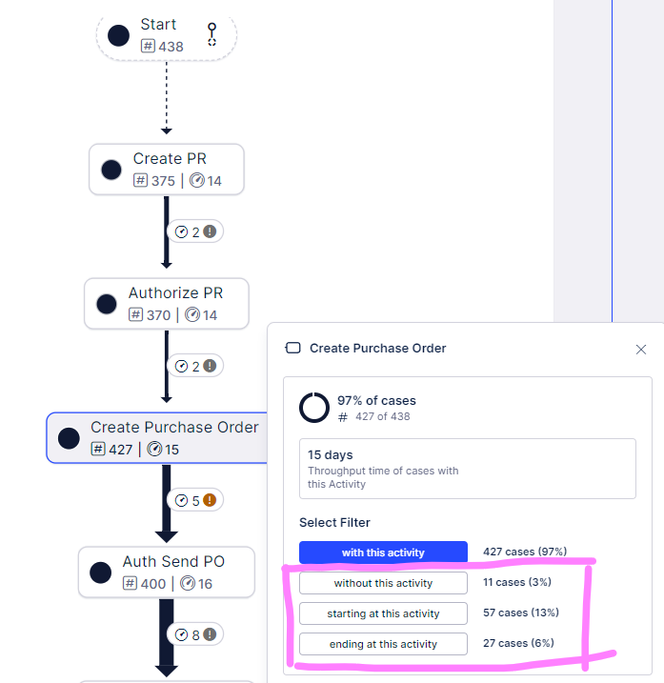
Bottlenecks

Slide 12
Questions answered
Does the process always run as it should? 84% yes, but 16% there are incomplete data – which requires time consuming investigation/process deviation/manual steps at later stage of the process (e.g.: invoicing).
What variants do you see? And how often do they occur? Total 72 cases (16%) does not follow standard process, 29 is due to PR/PO rejection and 43 cases for other reason. For detailed analysis please check next slide.
Are there any conflicts in terms of separation of functions? Yes, there is Segregation of Duties (SoD) conflict, Fraud Risk: EdjeK is an employee who has the authorization to create purchase order, approve & send PO and also confirm the good receipt. These 3 roles to be segregated among 3 different colleague.
What opportunities for process optimization do you identify? I see here 2 approaches: 1. First is to make proccess improvement (lead time) on the process where the steps are following the standard process flow 2. Second is to analyze those items where standard process can not be followed: for example reduction of PR/PO rejection cases (29 cases - 6%). There are cases where the PO is rejected due to missing values, however this should have been identified earlier at PR level.
What improvement initiatives would you suggest? IT improvements: 1. Making some feature of the PR/PO record obligatory → not beind able to submit any step in case of misisng infos 2. Automation: based on internal discussion in some cases (below a cetain treshold per material group) no approval needed → automated process flow
What information would you still like to receive from Green Air Inc.? Following infos needed for deeper process understanding: - What infos needs to be provided on PR? Is it possible that PR can contain different infos then PO? For example as per the current process it’s compliant if PR has no supplier name, but the PO requires such info? - As per the current process is it possible to create PO without PR?

Slide 13
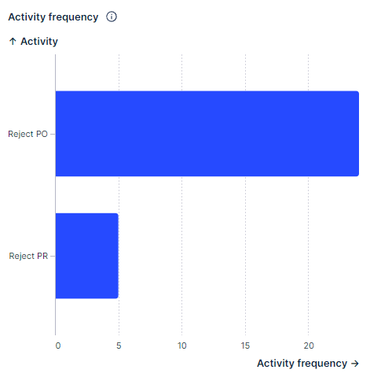
Process deviation scenarios - asking the right question for better understanding
Scenario1: PR created, PR approved, PO created --> PO rejection. 1% of total case. (4 cases) What kind of infos needs to be provided on the PO-s which are not provided at PR level?
Scenario2: PR created --> PR rejection – rejected as early as possible. 1% of total case. (5 cases) Were these PR-s and raised later? Were these cases PR-s are raised by human mistake or is there any other reason behind?
Scenario3: PR created (no PR number generated), PR approved, PO created --> PO rejection. 4,5 % of total case. (20 cases) How is it possible that PO can be created without PR number? Isn’t the PR ID generation prerequisite of PO drafting? In case of no → improvement for making it mandatory
Scenario4: No PR number, no PO number, but there is --> timestamp for receive goods. 1% of total case (6 cases) Have it gone through the process and is this receive good real or is it a technical bug? Is there any invoice belonging to this and was it the payment completed?
Scenario5: No PR number, but PO is created and sent to supplier, goods received 8% of total case (37 cases) In 34 cases there is info auth & send and the receive goods - except for 3 cases: 1403, 1412, 1437 – only PO creation info. This is non-compliant → IT improvement with obligatory fields can help on this process deviation.

Slide 14
Overall recommendations
Process optimization:
Lead time improvement on the standard process:
reduction of the 8 working days from sending the PO to the supplier and good receipt: starting with the top 3: Opentech, year-job, Faxquote (Golddex, Isdom, Condax...)
Reduction of the 5 working days from PO creation to PO approval & send: discussion with RobvdL and FritsS in order to understand the reason behind
b. Process improvement in case of process deviation:
reduction of the number of PR/PO rejection, currently it is 6% of the total cases. In case a PR/PO needs to be rejected, ideally it should be rejected in the beginning of the process.
Scenario reviews: Starting with scenario5 since it gives 8% of the total cases.
Segregation of duties conflict: redefine the responsibilities of EdjeK and remove the PO approval and good receipt person, keeping only the PO creation.
3. Improvement initiation: IT improvements regarding the below points:
Making PR/PO record features fulfillment mandatory (for example PR ID generation to be prerequisite of PO and PO not to be submitted without supplier name, material info and purchase value).
Automation: below certain treshold per material groups

